Slide 1
FIFTH CIRCUIT UPDATE
DAVID S. COALE
27th Annual Conference on State & Federal Appeals
Austin, TX
June 2, 2017

Slide 2

“The 5th U.S. Circuit Court of Appeals is widely viewed as one of the nation's most conservative federal appellate courts . . . ”

Slide 3
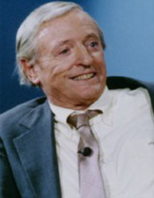
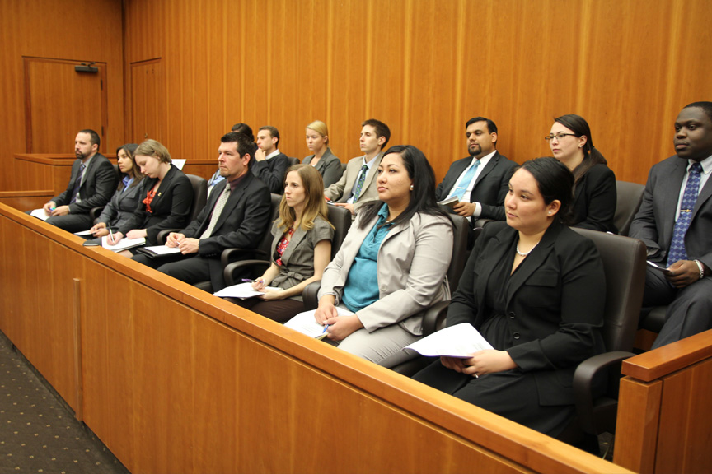
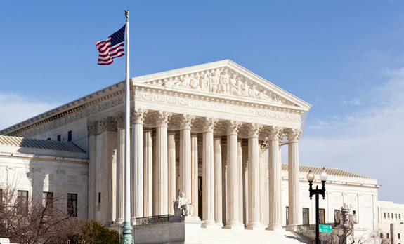
Political Conservatism
7th Amendment Conservatism
Article III Conservatism

Slide 4
PLEADINGS

Slide 5
Fed’l Ins. v. Northfield Ins., 837 F.3d 548 (5th Cir. 2016)
“But because of the breadth and generality of the allegations in ExxonMobil's state court petition, we cannot say that all of the claims fall clearly within the exclusion. . . . ExxonMobil's petition does not attach any of the petitions in the Louisiana Litigation. . . . ExxonMobil's petition asserts only that ‘[a]ll three lawsuits in the underlying [Louisiana] litigation allege environmental damage and seek restoration and remediation of the land subject to mineral rights purchased by the Wagner Group.’ . . . [T]hese assertions do not clearly allege claims that are all excluded by the Pollution Endorsement.”

Slide 6
“To survive a motion to dismiss, a complaint must contain sufficient factual matter, accepted as true, to state a claim to relief that is plausible on its face.”
Ashcroft v. Iqbal, 556 U.S. 662, 678-79 (2009).
Alexander v. Ameripro, 848 F.3d 698 (5th Cir. 2017) “These plaintiffs have plausibly alleged that AmeriPro refused to consider their Section 8 income in assessing their creditworthiness as mortgage applicants, and that they received mortgages on less favorable terms and in lesser amounts than they would have had their Section 8 income been considered.” |  | Thomas v. Chevron USA, 832 F.3d 586 (5th Cir. 2016) “Thomas alleged that Chevron knew about of the real risk of piracy in the region and of the specific threats received by the [ship]. He alleged that despite its knowledge, Chevron requested that the [ship] take an unaccompanied support trip that would pass by the source of the recent threats. Finally, he alleged that Chevron broadcast his route information and locations over easily-accessible VHF radios, through which they could be heard by pirates known to be in the area.”

Slide 7
“OBJECTIVELY REASONABLE BASIS”

Slide 8
Omega Hosp. LLC v. Louisiana Health Serv. & Indem.,
No. 13-31085 (5th Cir. 2014)
“Blue Cross argues that because it administers the Service Benefit Plan at the direction of OPM, it acts under an officer of the United States and it had grounds to assert federal court jurisdiction. . . .
In light of case law arguably supporting Blue Cross, and the absence of a ruling from this court, we cannot say that Blue Cross lacked a reasonable belief in the propriety of removal.”

Slide 9
Renegade Swish v. Wright, ___ F.3d ___,
No. 16-11152 (5th Cir. May 22, 2017)
“As compared to Riverside Construction, where the disagreement among the courts was ‘hotly contested,’ any disagreement here is tepid and lopsided. Similarly, this Court has found a defendant's removal objectively reasonable when case law from other circuits arguably supported removal and this Circuit had not yet decided the precise question. But here, Renegade Swish points only to Hickman as a post-Holmes Group case that supports its position on removal, a case from which district courts have since distanced themselves.”

Slide 10

DIVERSITY – CITIZENSHIP

Slide 11
Smitherman v. Bayview Loan Servicing LLC,
No. 16-20328 (5th Cir. 2017)
“Accordingly, we order a limited REMAND to the district court to permit supplementation of the record and to make findings regarding Bayview's citizenship. After the district court has made these determinations, the district court's amended opinion shall return to this panel for appropriate action. We retain jurisdiction during the pendency of the limited remand.”

Slide 12
“HEY, THAT’S AN UNPUBLISHED OPINION”

Slide 13
5th Cir. Rule 47.5.4
“Unpublished Opinions Issued on or After January 1, 1996”
“Unpublished opinions issued on or after January 1, 1996, are not precedent, except under the doctrine of res judicata, collateral estoppel or law of the case (or similarly to show double jeopardy, notice, sanctionable conduct, entitlement to attorney’s fees, or the like). . . . .”

Slide 14
Richard v. Dolphin Drilling, 832 F.3d 246 (5th Cir. 2016)
“While [Appellant] is correct, we find Cash’s reasoning compelling and hold that the district court was correct . . . .”

Slide 15
CONTRACTS / SETTLEMENTS

Slide 16
Lake Eugenie Land & Devel. v. BP,
___ F.3d ___, No. 15-30377 (5th Cir. May 23, 2017)
“[In interpreting a settlement, surely some weight has to be given to what damages recoverable in civil litigation actually are.” “BP argues that the ISMs are necessary in order to ensure that the Claims Administrator can ‘process claims in accordance with economic reality,’ quoting our opinion in Deepwater Horizon I.” | “When we said, in Deepwater Horizon I, that the Claims Administrator should ‘process claims in accordance with economic reality,’ we assumed that doing so would comport with the text of the Settlement Agreement. That assumption has proven to be wrong in light of the moving, smoothing, and otherwise reallocation of revenue inherent in the ISMs. The Settlement Agreement grants claimants the right to choose their own Compensation Period. Because the ISMs infringe upon that right, the district court’s approval of the ISMs was in error and is reversed.”

Slide 17
SUMMARY JUDGMENT

Slide 18
Orr v. Copeland, __ F.3d __, No. 16-50023 (5th Cir. 2016)
“”There is no evidence to suggest that the pair was biased, and the district court specifically found that the heirs ‘[did] not offer any evidence to contradict the eyewitnesses’ statements.’ Because their testimony was ‘uncontradicted and unimpeached,’ the district court was required to give it credence. Failure to do so amounted to an inappropriate ‘credibility determination

Slide 19

Maldonado v. CitiMortgage, No. 16-20541 (5th Cir. 2017)
Maldonado:
“disputed the amounts that CitiMortgage claimed in attorneys’ fees, inspection fees, escrow, taxes, and late charges,” but
did “not provide any evidence of
what the correct amounts should be.”

Slide 20

PRIVILEGE LOGS

Slide 21
EEOC v. BDO Seidman LLP, ___ F.3d ___,
No. 16-20314 (May 4, 2017)
Substance. “[N]umerous log entries fail to identify a sender, recipient, date, or provide a substantive description of the subject matter . . . [s]ome entries have only vague descriptions such as ‘discrimination claim,’ ‘internal investigation,’ or ‘work environment claim’”
Email chains. “Emails involving counsel are also problematic, as the log’s descriptions do not indicate whether a particular entry consists of one email or a string of emails – a distinction that may be dispositive as to whether the privilege applies.”

Slide 22
EEOC v. BDO Seidman LLP, ___ F.3d ___,
No. 16-20314 (May 4, 2017)
Business/Legal distinction. “[N]ot only does the log include conclusory descriptions of ‘legal advice,’ it does so in the context of communications with in-house counsel – an area court have acknowledged presents unique challenges . . . further compounded where HR personnel, such as Bower, are involved.” The Court noted the issues raised in Bower’s declaration.
Disclosure. “[T]he log leaves open questions about (1) whether emails courtesy copied to a third party remained privileged . . . (2) whether matters communicated to attorneys were done so with the intention of remaining privileged . . . and (3) whether non-attorney individuals to whom communications were sent were within the sphere of confidence . . . .”

Slide 23
WAIVER

Slide 24
Smith Group v. Forrest Gen’l Hosp.,
No. 16-60134 (5th Cir. 2016)
“. . . to be preserved, an argument must be pressed, not merely intimated.”

Slide 25
NOTICES OF APPEAL

Slide 26

Sudduth v. Texas Health & Human Servcs. Comm’n,
830 F.3d 175 (5th Cir. 2016)
“Sudduth argues that she was not made aware of any jurisdictional defect until this court requested briefing on this issue and that, at the very least, Franklin should not be retroactively applied to her case because it is new law. But, as previously discussed, the local rules and procedures here were sufficiently clear as to the requirements for timely filing, and the onus is on Sudduth, not the court, to be aware of and cure any deficiencies in the notice of appeal.”

Slide 27
Netsch v. Sherman, No. 16-10432 (Dec. 22, 2016)
”[T]he bankruptcy court concluded that the reason for the delay weighed strongly against finding excusable neglect. In its analysis of this factor, the bankruptcy court emphasized that the parties had been subject to the Federal Rules of Bankruptcy Procedure throughout the adversary proceeding, these rules were unambiguous, and Appellants’ counsel confused the Federal Rules of Bankruptcy Procedure with the Federal Rules of Civil Procedure. The bankruptcy court also indicated that confusing bankruptcy procedure with civil procedure does not constitute excusable neglect. Consequently, the court held that the reason for the delay should be given greater weight than other factors.”

Slide 28
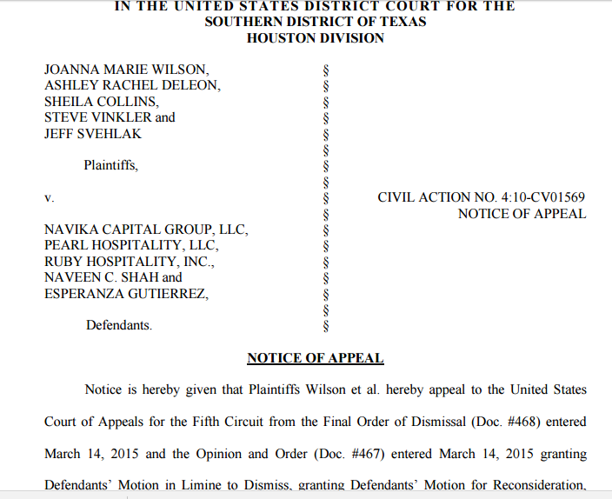
Wilson v. Navika Capital Group, No. 15-20204 (5th Cir. 2016)

Slide 29
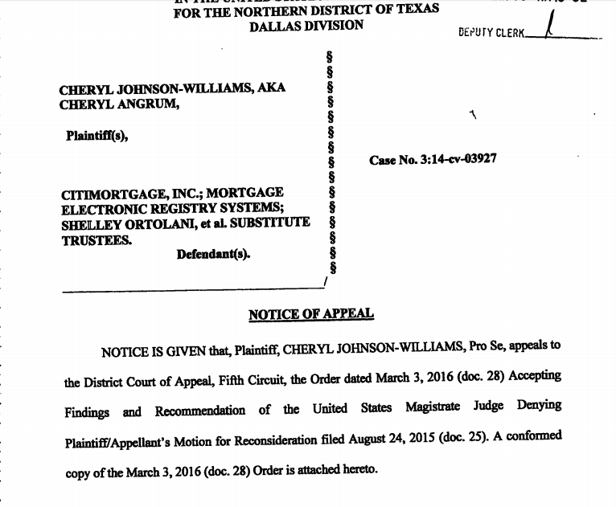
Johnson-Williams v. MERS, No. 16-10276 (5th Cir. 2017)

Slide 30
A CLOSING NOTE ON “CONSERVATISM”

Slide 31
“[W]e conclude that if the Plaintiffs prove that the Defendants operated a fraudulent pyramid scheme, a jury may reasonably infer from the Plaintiffs' payments to join . . . that they relied on Ignite's implicit representation of legitimacy, when in fact it was a fraudulent pyramid scheme.”
Torres v. S.G.E. Management, 838 F.3d 629 (5th Cir. 2016) (en banc)
JUDGES IN MAJORITY Wiener* Costa* Stewart Davis Smith Dennis Prado Elrod Southwick Graves Higginson |  | JUDGES DISSENTING Jolly Jones Clement Owen Haynes

Slide 32
FIFTH CIRCUIT UPDATE
DAVID S. COALE
27th Annual Conference on State & Federal Appeals
Austin, TX
June 2, 2017

