Slide 1
CURRENT ISSUES IN COMMERCIAL LAW
DAVID S. COALE
Fifth Circuit Bar Association
New Orleans, LA
October 2, 2017

Slide 2

“The 5th U.S. Circuit Court of Appeals is widely viewed as one of the nation's most conservative federal appellate courts . . . ”

Slide 3

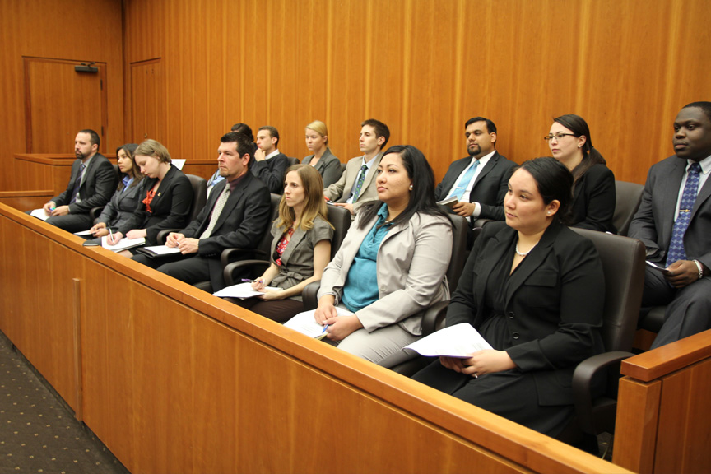
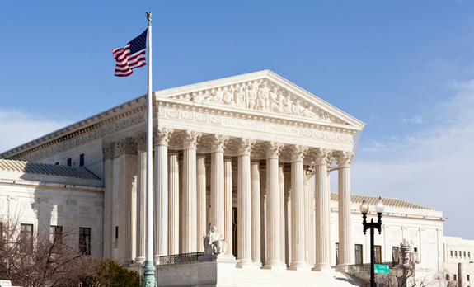
Political Conservatism
7th Amendment Conservatism
Article III Conservatism

Slide 4
PLEADINGS

Slide 5
Fed’l Ins. v. Northfield Ins., 837 F.3d 548 (5th Cir. 2016)
“But because of the breadth and generality of the allegations in ExxonMobil's state court petition, we cannot say that all of the claims fall clearly within the exclusion. . . . [1] ExxonMobil's petition does not attach any of the petitions in the Louisiana Litigation. . . . [2] ExxonMobil's petition asserts only that ‘[a]ll three lawsuits in the underlying [Louisiana] litigation allege environmental damage and seek restoration and remediation of the land subject to mineral rights purchased by the Wagner Group.’ . . . [T]hese assertions do not clearly allege claims that are all excluded by the Pollution Endorsement.”

Slide 6
CONTRACTS / SETTLEMENTS

Slide 7
Lake Eugenie Land & Devel. v. BP,
___ F.3d ___, No. 15-30377 (5th Cir. May 23, 2017)
“[In interpreting a settlement, surely some weight has to be given to what damages recoverable in civil litigation actually are.” “BP argues that the ISMs are necessary in order to ensure that the Claims Administrator can ‘process claims in accordance with economic reality,’ quoting our opinion in Deepwater Horizon I.” | “When we said, in Deepwater Horizon I, that the Claims Administrator should ‘process claims in accordance with economic reality,’ we assumed that doing so would comport with the text of the Settlement Agreement. That assumption has proven to be wrong in light of the moving, smoothing, and otherwise reallocation of revenue inherent in the ISMs. The Settlement Agreement grants claimants the right to choose their own Compensation Period. Because the ISMs infringe upon that right, the district court’s approval of the ISMs was in error and is reversed.”

Slide 8
SCA Promotions v. Yahoo!,
___ F.3d ___, No. 15-11254 (5th Cir. Aug. 21, 2017)
“According to the district court, ‘[n]owhere does the Contract specify or identify the invoices, when they will be paid, or otherwise provide that the fee is $11 million.’ But the Contract references ‘invoice(s)’ several times, and it provides that ‘[t]his contract, including exhibits and attachments, represents the entire final agreement between Sponsor [Yahoo] and SCA, and supersedes any prior agreement, oral or written.’”

Slide 9
Total E&P USA v. Kerr-McGee Oil & Gas,
719 F.3d 424 (5th Cir. 2013)
DISTRICT COURT:
“[T]he subject ‘Calculate and Pay’ clauses are not ambiguous because they clearly provide that the overriding royalties ‘shall be calculated and paid in the same manner and subject to the same terms and conditions as the landowner’s royalty under the Lease.”
MAJORITY:
“Those clauses do not clearly and explicitly state that payment of overriding royalties shall be suspended . . . Consequently, . . . a court may not find that the parties intended to suspend the overriding royalty obligation based exclusively on the words of the calculate and pay clauses but must interpret the overriding royalty contracts further in search of the parties' common intent.”
CONCURRENCE:
“Appellees' argument points to meaning from a different grammatical arrangement , , , , [H[ad the sentence separated that dependent clause by commas . . . Appellees would have a stronger argument as to clarity of meaning. Given the language of the contracts, however, I cannot say that, for the reasons above, the sentence is free of ambiguity.”
DISSENT:
“Because royalty suspension is a term or condition . . . and the ‘calculate and pay’ clauses of the assignment contracts make the overriding royalty interests subject to the same terms and conditions as the landowner's royalty under the lease, I respectfully dissent from the majority's conclusion that the assignment contracts are ambiguous.. . . The district court erred by failing to admit Appellants' extrinsic evidence of mutual mistake. When making a claim for reformation the claimant may offer parol[] evidence, not to vary the terms of the written instrument, but to show the ‘writing does not express the true intent or agreement of the parties.’”

Slide 10
SUMMARY JUDGMENT

Slide 11

Naylor v. Securiguard, Inc., 801 F.3d (5th Cir. 2015)
“Unlike a requirement that the employee stay in uniform, or even one that may result in the employee having to perform a duty on rare occasions, a jury could find that preventing the employee from eating—ostensibly the main purpose of the break—for twelve out of thirty minutes during every break is a meaningful limitation on the employee’s freedom. The travel obligation
thus cannot be deemed a mere
‘inconvenience’ as a matter of law.”

Slide 12

St. Bernard Parish v. Lafarge N. Am.,
No. 13-30030 (5th Cir. Dec. 19, 2013)
“There is a great deal of testimony
supporting Lafarge’s position, to be sure, and little to support the Parish’s, but we are mindful of the summary judgment standard . . . .”

Slide 13
DRAFTING INJUNCTIONS

Slide 14
Scott v. Schedler, 826 F.3d 207 (5th Cir. 2016)
“[T]he injunction refers generally to the defendant's policies without defining what those policies are or how they can be identified.”

Slide 15
Test Masters Educational Services v. Singh Educational Services, 791 F.3d 561 (5th Cir. 2015) (vacating contempt finding against an attorney for allegedly encouraging his client to make inappropriate online postings, finding inadequate notice and a lack of evidence that the attorney had personally violated the relevant injunction)
Oaks of Mid City Resident Council v. Sebelius, 723 F. 3d 581, 585-86 (5th Cir. 2013) (reversing contempt order about injunction related to termination of a nursing home’s Medicare contract)
Hornbeck Offshore Services LLC v. Salazar, 713 F. 3d 787, 795 (5th Cir. 2012) (reversing contempt order, noting: “In essence, the company argues that by continuing in its pursuit of an effective moratorium, the Interior Department ignored the purpose of the district court's injunction. If the purpose were to assure the resumption of operations until further court order, it was not clearly set out in the injunction.”)

Slide 16

DRAFTING INJUNCTIONS

Slide 17
MANDAMUS

Slide 18
In re: DuPuy Orthopaedics, Inc.
___ F.3d ___ (5th Cir. Aug. 31, 2017)
 | Judge Jones | Judge Smith | Judge Costa
1. Clear error? | Yes | Yes | N/A
2. Lack of adequate remedy? | No | Yes | Yes
3. Request? | Yes | Yes | No

Slide 19
In re: DuPuy Orthopaedics, Inc.,
___ F.3d ___ (5th Cir. Aug. 31, 2017)
“Despite finding serious error, a majority of this panel denies the writ that petitioners seek to prohibit the district court from proceeding to trial on plaintiffs’ cases.”
“Petitioners claim that appeal is not an adequate remedy because the cost of having to defend more bellwether trials is ‘unjustifiable’ given the strength of their personal-jurisdiction claims. . . . At oral argument, the parties represented that each of the previous three bellwether trials lasted several weeks. But for appeal to be an inadequate remedy, there must be ‘some obstacle to relief beyond litigation costs that renders obtaining relief not just expensive but effectively unobtainable.’ Nor is the ‘hardship [that] may result from delay’—such as the risk of substantial settlement pressure—grounds for granting a mandamus petition.”

Slide 20
In re: Crystal Power Co., 841 F.3d 82 (5th Cir. 2011)
“We confess puzzlement over why respondents insist on litigating this case in federal court even though, as our previous opinion explained, any judgment issued by the district court will surely be reversed — no matter which side it favors — for lack of federal jurisdiction due to improper removal.”

Slide 21
In re: Trinity Indus., Inc., No. 14-41-67
(5th Cir. Oct. 10, 2014)
“The court is compelled to note, however, that this is a close case. The writ is timely and the litigation stakes–the potential for a $1 billion adverse judgment–are unusually high. This court is concerned that the trial court, despite numerous timely filings and motions by the defendant, has never issued a reasoned ruling rejecting the defendant’s motions for judgment as a matter of law.”

Slide 22
ARBITRATION

Slide 23

Nelson v. Watch House Int’l, LLC,
815 F.3d 190 (5th Cir. 2016)
“Here, the Plan provides that Watch House may make unilateral changes to the Plan, purportedly including termination, and that such a change ‘shall be immediately effective upon notice to’ employees. Watch House’s
retention of this unilateral power to terminate the Plan without advance notice renders the plan illusory under a plain reading of Lizalde [v. Vista Quality Markets, 746 F.3d 222 (5th Cir. 2014)].

Slide 24
Vine v. PLS Fin. Servcs., No. 16-50847
(5th Cir. May 19, 2017)
Substantially invoke judicial process. “[B]y allegedly submitting false worthless check affidavits, PLS ‘invoke[d] the judicial process to the extent it litigate[d] a specific claim it subsequently [sought] to arbitrate.’ . . . [A]ll claims involve whether PLS misled or threatened Vine, Pond, and the class of PLS customers they purport to represent in order to obtain outstanding debt owed to PLS.”
Prejudice. “’Prejudice in the context of arbitration waiver refers to delay, expense, and damage to a party’s legal position.’ Here, Vine and Pond would have borne the costs of defending against any theft by check prosecution. In addition, they would have suffered the preclusive effect of a conviction in any subsequent litigation. Consequently, they have sufficiently shown detriment or prejudice.’” (citations omitted, both quotes).

Slide 25
BNSF Railway Co. v. Alstom Transp.,
777 F.3d 785 (5th Cir. 2015)
“[The] question for decision by a federal court asked to set aside an arbitration award . . . is not whether the arbitrator or arbitrators erred in interpreting the contract; it is not whether they clearly erred in interpreting the contract; it is not whether they grossly erred in interpreting the contract, it is whether they interpreted the contract

Slide 26
ANTI-SLAPP LAWS

Slide 27

Block v. Tanenhaus, ___ F.3d ___ (5th Cir. Aug. 15, 2017)
"Under the Erie doctrine, federal courts sitting in diversity apply state substantive law and federal procedural law. If there is a ‘direct collision’ between a state substantive law and a federal procedural rule that is within Congress's rulemaking authority, federal courts apply the federal rule and do not apply the substantive state
law. . . . The applicability of state
anti-SLAPP statutes in federal court
is an important and unresolved
issue in this circuit.”

Slide 28
A CLOSING NOTE ON “CONSERVATISM”

Slide 29
“[W]e conclude that if the Plaintiffs prove that the Defendants operated a fraudulent pyramid scheme, a jury may reasonably infer from the Plaintiffs' payments to join . . . that they relied on Ignite's implicit representation of legitimacy, when in fact it was a fraudulent pyramid scheme.”
Torres v. S.G.E. Management, 838 F.3d 629 (5th Cir. 2016) (en banc)
JUDGES IN MAJORITY Wiener* Costa* Stewart Davis Smith Dennis Prado Elrod Southwick Graves Higginson |  | JUDGES DISSENTING Jolly Jones Clement Owen Haynes

Slide 30
CURRENT ISSUES IN COMMERCIAL LAW
DAVID S. COALE
Fifth Circuit Bar Association
New Orleans, LA
October 2, 2017

